Slide 1

Let's Rust!
System programming is great again!

Slide 2
Who am I ?
Karl Lam
99% Vegan, Combat skills, Chinese Calligraphy
https://github.com/karlvlam/hkosc2017-demo
DevOps@OneSky (We are hiring!)

Slide 3
History
1970s-80s: C, C++
1990s: Java, Javascript, Ruby, PHP, Python...
2000s: Scala, Go, Rust

Slide 4
Why Rust ?
Memory Safety (Ownership)
Modern syntax (Match, Trait...)
Package management (Cargo & crates)
Bare Metal (no GC, self-contained)

Slide 5
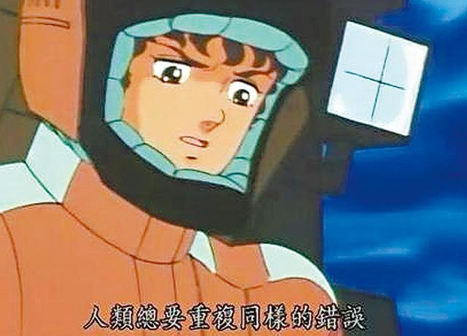
Memory Safety

Slide 6
Memory Safety
Ownership
Borrowing
Lifetime

Slide 7
Ownership
Avoid dangling pointer (use after free)
Check at compile time (less human mistake)
No GC (effective)

Slide 8
Ownership
Copy vs owned
Move vs borrow

Slide 9
Borrowing rules
Many immutable borrows
One mutable borrow, no other (im)mutable borrows

Slide 10
Pattern Matching
Include all cases
expression

Slide 11
Concurrency - Threads
Channel (data exchange)
Mutex (shared state)

Slide 12
Concurrency - Async I/O
External libraries (mio, tokio...)
Some support for standard library
Future is the future

Slide 13
Reference
The Rust Programming Language https://doc.rust-lang.org/book/
Tokio https://tokio.rs/

